Slide 1
Artificial Intelligence (AI-2002)
Lecture 10: Constraint Satisfaction Problems
Mr. Saif ur Rehman (Lecturer – AI & DS)
saifurrehman@nu.edu.pk

Slide 2
What we have already covered
What is a state space in problem-solving?
How are problems represented in a state space?
What is the purpose of domain-specific heuristics?
Why is each state considered atomic in a search algorithm?
Why do we need domain-specific code for each problem?

Slide 3
Constraint Satisfaction Problems
In which we see how treating states as more than just little black boxes leads to new search methods and a deeper understanding of problem structure.

Slide 4
Constraint Satisfaction Problems
In this chapter we break open the black box by using a factored representation for each state:
a set of variables, each of which has a value.
A problem is solved when each variable has a value that satisfies all the constraints on the variable.
A problem described this way is called a constraint satisfaction problem, or CSP.

Slide 5
Constraint Satisfaction Problems
CSP search algorithms take advantage of the structure of states and use general rather than domain-specific heuristics to enable the solution of complex problems.
The main idea is to eliminate large portions of the search space all at once by identifying variable/value combinations that violate the constraints.
CSPs have the additional advantage that the actions and transition model can be deduced from the problem description.

Slide 6
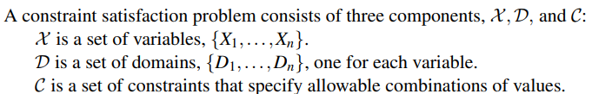
Defining Constraint Satisfaction Problems
A domain, , consists of a set of allowable values, {v1,..., vk}, for variable .
A Boolean variable would have the domain {true,false}.
Different variables can have different domains of different sizes.

Slide 7
Defining Constraint Satisfaction Problems
Each constraint consists of a pair
scope is a tuple of variables that participate in the constraint and rel is a relation that defines the values that those variables can take on.
For example, if X1 and X2 both have the domain {1,2,3}, then the constraint saying that X1 must be greater than X2 can be written as

Slide 8

Defining Constraint Satisfaction Problems
CSPs deal with assignments of values to variables,
An assignment that does not violate any constraints is called a consistent or legal assignment.
A complete assignment is one in which every variable is assigned a value.
A solution to a CSP is a consistent, complete assignment.
A partial assignment is one that leaves some variables unassigned.
A a partial solution is a partial assignment that is consistent.

Slide 9
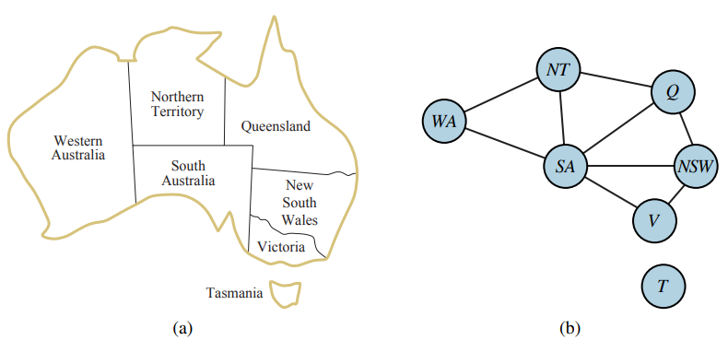
Example problem: Map coloring

Slide 10

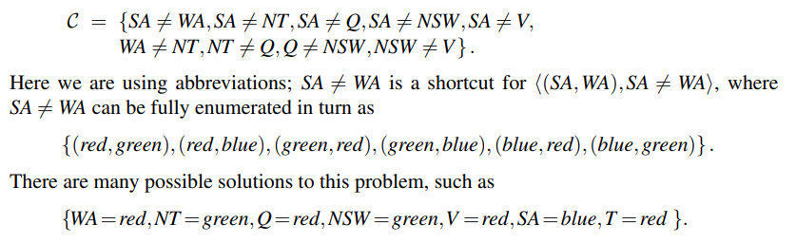
Example problem: Map coloring

Slide 11
Why formulate a problem as a CSP?
Many problems can be easily expressed as a CSP using variables, domains, and constraints.
CSP solvers can quickly prune large swathes of the search space that an atomic state-space searcher cannot.
For example, once we have chosen {SA=blue} in the Australia problem, we can conclude that none of the five neighboring variables can take on the value blue.
A search procedure that does not use constraints would have to consider 3^5 =243 assignments for the five neighboring variables; with constraints we have only 2^5 =32 assignments to consider, a reduction of 87%.

Slide 12


Example problem: Job-shop scheduling
We consider a small part of the car assembly, consisting of 15 tasks: install axles (front and back), affix all four wheels (right and left, front and back), tighten nuts for each wheel, affix hubcaps, and inspect the final assembly. We can represent the tasks with 15 variables:
In our example, the axles have to be in place before the wheels are put on, and it takes 10 minutes to install an axle, so we write

Slide 13
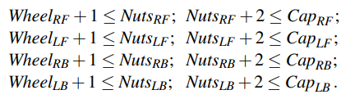
Example problem: Job-shop scheduling
In our example, the axles have to be in place before the wheels are put on, and it takes 10 minutes to install an axle, so we write

Slide 14
Job-Shop Scheduling Task for a Class Timetable scenario
A university needs to schedule lectures in a limited number of classrooms while ensuring that:
No two classes are held in the same room at the same time (Disjunctive Constraint).
A course has multiple lectures that must follow a specific sequence (Precedence Constraint, e.g., Theory before Lab).

Slide 15
Job-Shop Scheduling Task for a Class Timetable scenario
Variables: Each lecture (including theory and lab) is a variable.
Let L={L1,L2,...,Ln} be the set of all lectures to be scheduled.
Domains:
The domain of each lecture consists of available (room, time slot) pairs.

Slide 16

Example problem: 8 Queen Problem

Slide 17
Example problem: 8 Queen Problem
A | B | C | D | E | F | G | H

Slide 18
Example problem: 8 Queen Problem
A | B | C | D | E | F | G | H
3 | 8 | 4 | 7 | 1 | 6 | 2 | 5
Domain:

Slide 19
Example problem: 8 Queen Problem
A | B | C | D | E | F | G | H
3 | 8 | 4 | 7 | 1 | 6 | 2 | 5
Domain: {1, 2, 3, 4, 5, 6, 7, 8}
Constraints:

Slide 20
Example problem: 8 Queen Problem
A | B | C | D | E | F | G | H
3 | 8 | 4 | 7 | 1 | 6 | 2 | 5
Domain: {1, 2, 3, 4, 5, 6, 7, 8}
Constraints: {A ≠ B ≠ C ≠ D ≠ E ≠ F ≠ G ≠ H},
A ≠ B±1, C±2, D±3, E±4, F±5, G±6, H±7

